Slide 1

DECODELABS · DATA SCIENCE
Tesla Stock Price
Prediction & Forecasting
An end-to-end machine learning project using EDA, feature engineering, and time-series modeling
Ernest Amanor Sawer · Data Scientist
TSLA

Slide 2
01
Project Overview & Dataset
AGENDA
02
EDA — Price & Volume Trends
What we'll cover today
03
EDA — Returns & Distributions
04
EDA — Correlation Heatmap
05
Machine Learning: Phase A & B
06
Actual vs Predicted & Roadmap

Slide 3


DATASET & PROJECT OBJECTIVES
Project Objectives
Dataset Snapshot
Analyze Tesla's historical stock performance
TICKER
TSLA (NASDAQ)
Visualize trends & trading behavior
PERIOD
Jan 2020 – Jan 2025
Build predictive ML models
ROWS
1,258 trading days
Identify & resolve information leakage
SOURCE
Yahoo Finance (yfinance)
Develop realistic next-day forecasting
FEATURES
Open, High, Low, Close, Volume

Slide 4
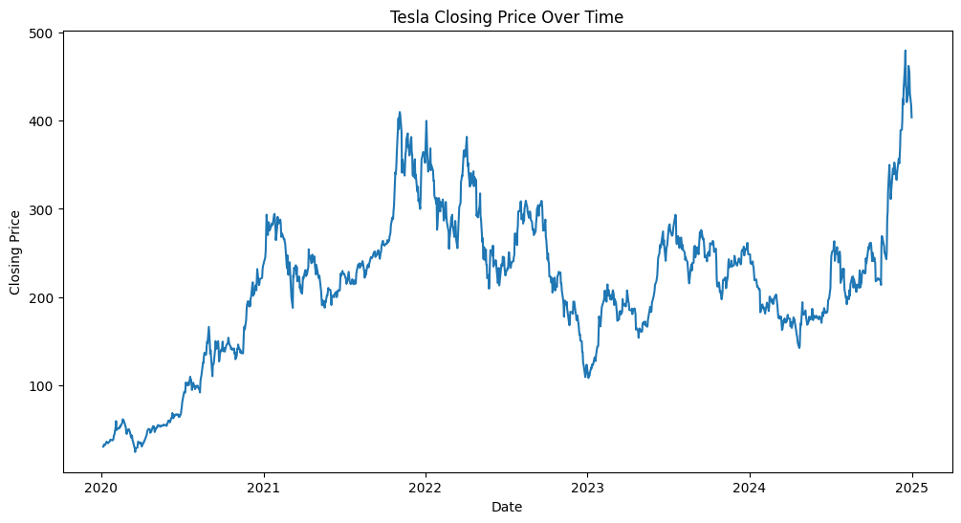
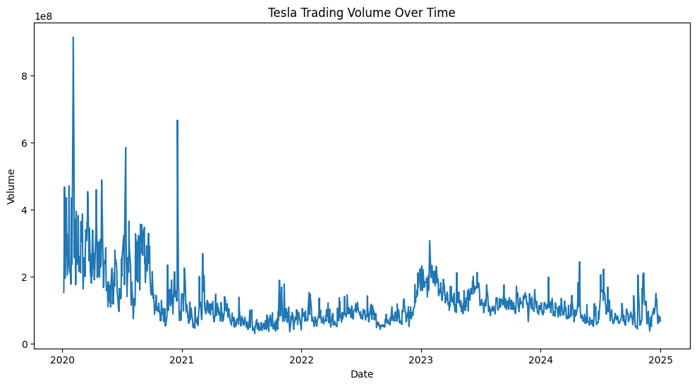
EDA — PRICE & VOLUME TRENDS
Tesla Closing Price Trend (2020–2025)
Trading Volume Trend
💡 Strong upward trajectory with ~9× growth; significant 2022 drawdown and 2024 recovery.
💡 Volume spikes align with major price moves and heightened investor attention.

Slide 5

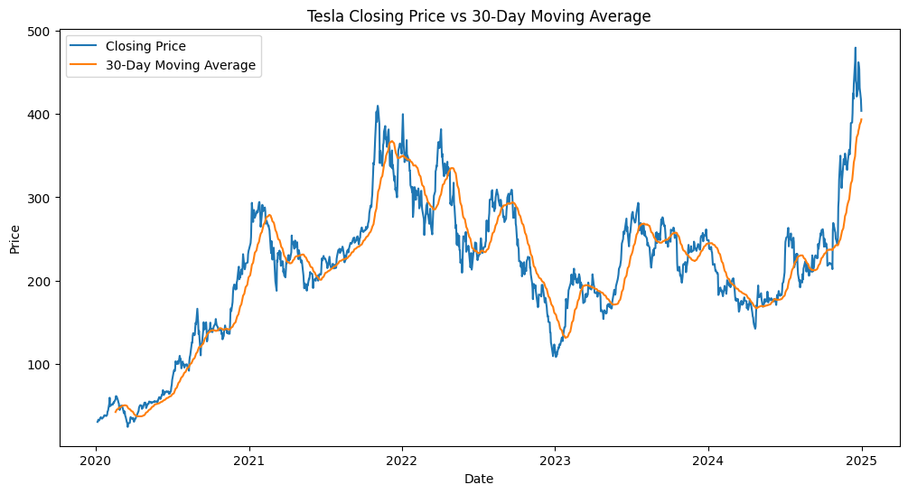
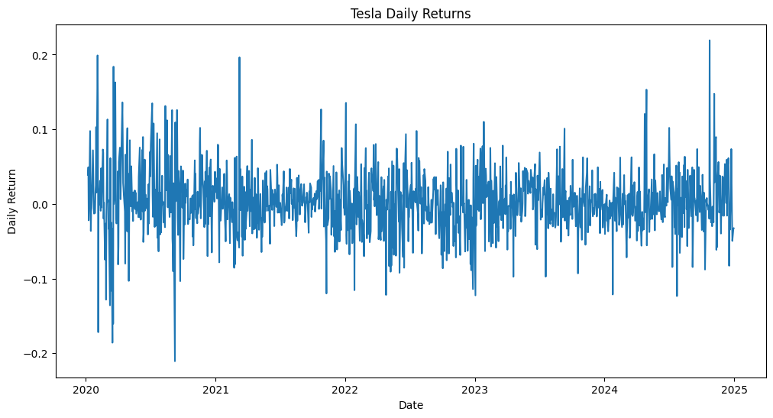
EDA — MOVING AVERAGE & DAILY RETURNS
30-Day Moving Average Analysis
Daily Returns Over Time
💡 MA smooths short-term noise and reveals underlying long-term direction clearly.
💡 Most daily returns cluster near zero; extreme outliers correspond to major news events.

Slide 6
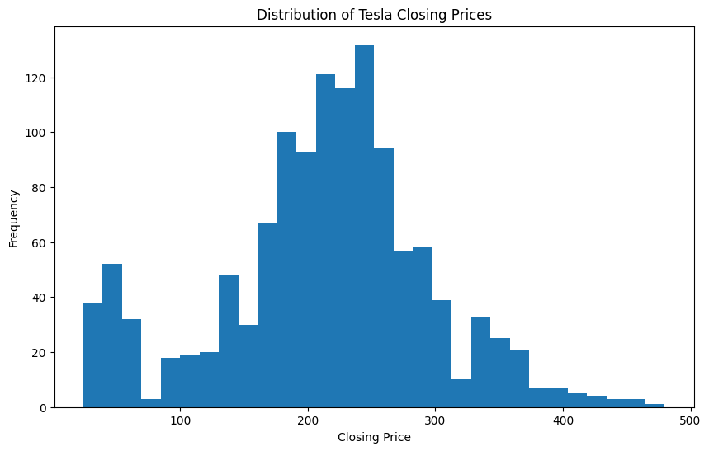
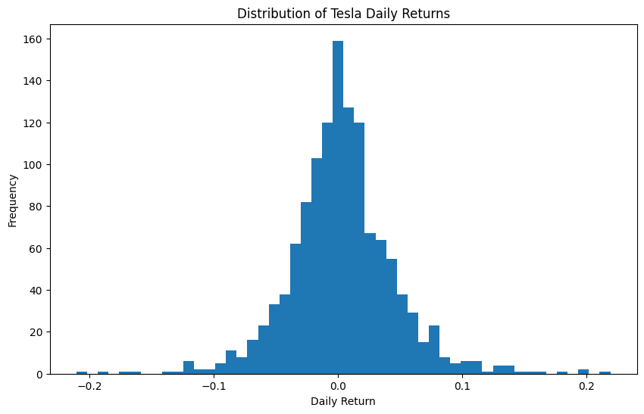
EDA — DISTRIBUTIONS OF PRICE & RETURNS
Distribution of Closing Prices
Distribution of Daily Returns
💡 Multi-modal distribution shows TSLA traded across distinct price regimes over 5 years.
💡 Approximately normal with slight fat tails — extreme gains/losses are infrequent but real.

Slide 7

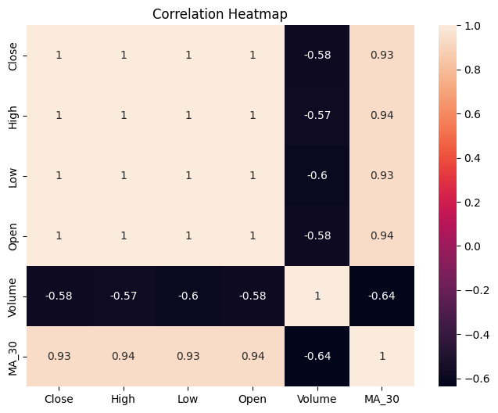

EDA — FEATURE CORRELATION HEATMAP
Pearson Correlation Matrix
Key Findings
Open, High, Low, Close are almost perfectly correlated (r ≈ 0.999)
Volume has a moderate negative correlation with price features
Multicollinearity among price cols informed feature selection
Only Open or Lag features needed — not all price columns simultaneously

Slide 8


PHASE A — SAME-DAY PREDICTION
Linear Regression — Close Price Prediction
Features Used
Model Results
→ Open Price
MAE
2.31
→ High Price
RMSE
3.23
→ Low Price
→ Volume Traded
R²
0.9986
Target: Closing Price
⚠ Information leakage detected — not suitable for real trading

Slide 9

PHASE B — REALISTIC NEXT-DAY FORECASTING
Engineered Features
Model Results
Lag_1
Previous day's close
MAE
7.40
Lag_2
Two days ago close
Mean Absolute Error
RMSE
MA_30
30-day moving average
11.06
Daily Return
(Close – Open) / Open
Root Mean Sq. Error
R²
Volume
Shares traded
0.9762
Target: Next-day Closing Price
Coefficient of Determination

Slide 10
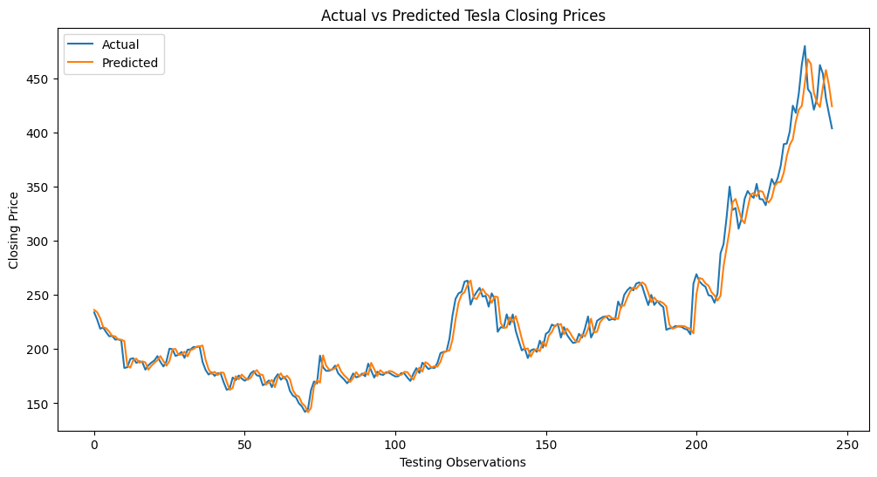
PHASE B — ACTUAL vs PREDICTED CLOSING PRICES
MAE 7.40 · avg error per day
RMSE 11.06 · penalizes outliers
R² 97.62% · variance explained

Slide 11

MODEL COMPARISON — PHASE A vs PHASE B
Key Lessons
High accuracy ≠ better model
Leakage creates false confidence
Realistic models use only prior data
R² of 0.976 is strong for stock forecasting

Slide 12
FUTURE ROADMAP
What's next for this project
Classification Models
LSTM Neural Networks
1
4
Predict price direction (up/down) with logistic regression & decision trees
Deep learning for long-range temporal dependencies in price series
TimeSeriesSplit CV
Streamlit Deployment
2
5
Temporal cross-validation to prevent future data leakage in evaluation
Live web app for real-time next-day stock price forecasting
Random Forest & XGBoost
3
Ensemble models to capture non-linear patterns in market data

Slide 13
Thank You
Ernest Amanor Sawer
Data Analyst · Data Scientist · Quantitative Analytics Enthusiast
github.com/Ernest717
DecodeLabs Data Science Internship · Tesla Stock Price Prediction

